Slide 1
Section 7.4
Trigonometric Functions of General Angles
Copyright © 2012 Pearson Education, Inc. Publishing as Prentice Hall.

Slide 2
Copyright © 2012 Pearson Education, Inc. Publishing as Prentice Hall.

Slide 3
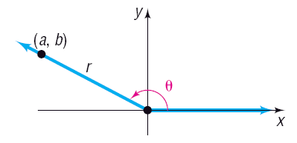
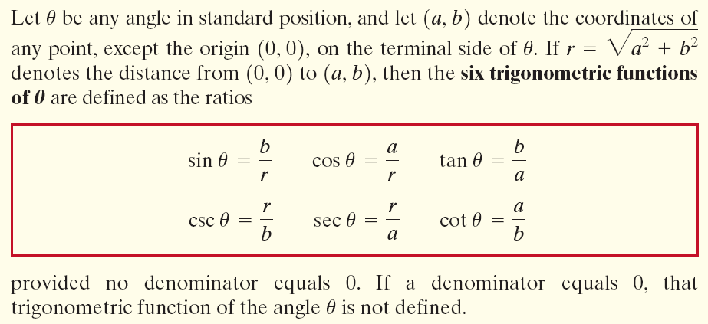
Copyright © 2012 Pearson Education, Inc. Publishing as Prentice Hall.

Slide 4
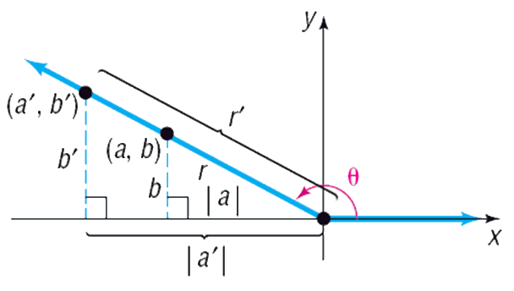
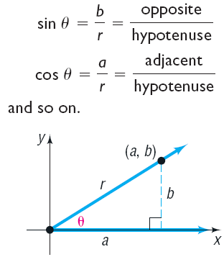
Copyright © 2012 Pearson Education, Inc. Publishing as Prentice Hall.

Slide 5

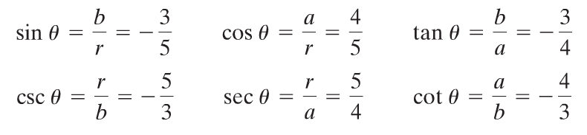
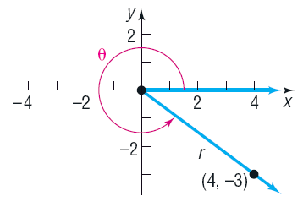
Copyright © 2012 Pearson Education, Inc. Publishing as Prentice Hall.

Slide 6
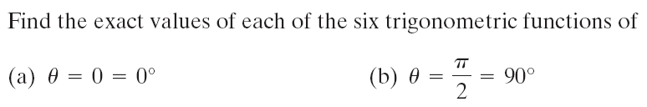
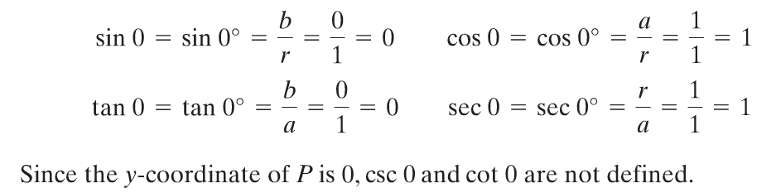
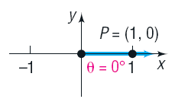
Copyright © 2012 Pearson Education, Inc. Publishing as Prentice Hall.

Slide 7
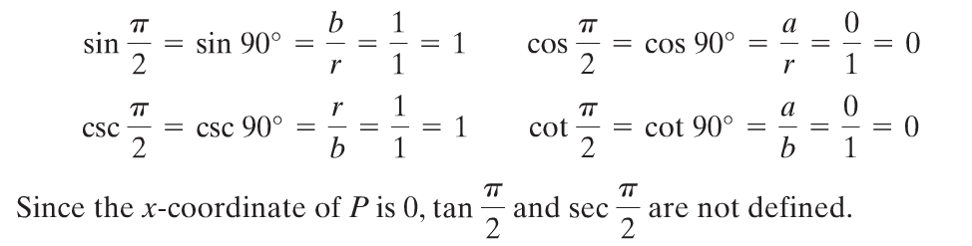
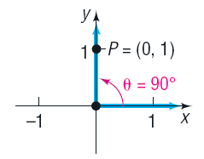
Copyright © 2012 Pearson Education, Inc. Publishing as Prentice Hall.

Slide 8
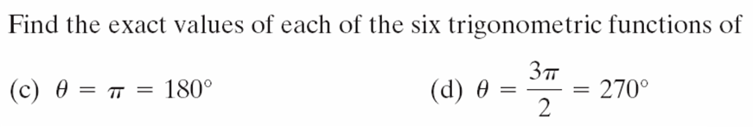
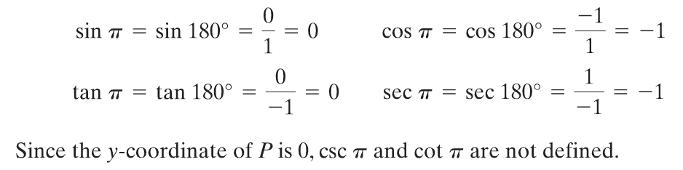
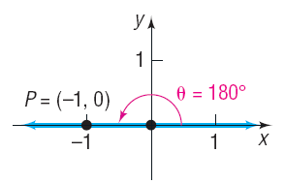
Copyright © 2012 Pearson Education, Inc. Publishing as Prentice Hall.

Slide 9
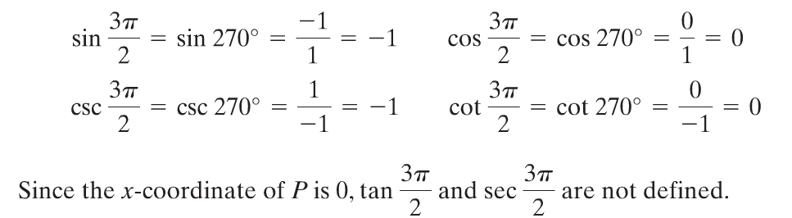
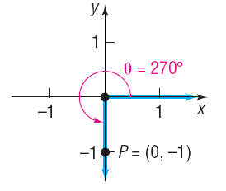
Copyright © 2012 Pearson Education, Inc. Publishing as Prentice Hall.

Slide 10
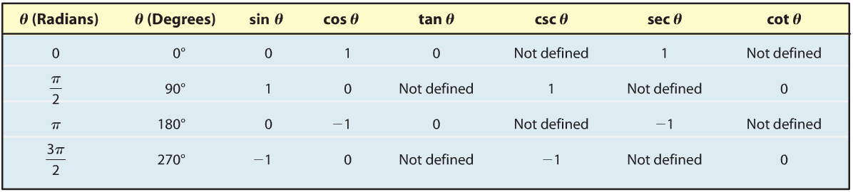
Copyright © 2012 Pearson Education, Inc. Publishing as Prentice Hall.

Slide 11

Copyright © 2012 Pearson Education, Inc. Publishing as Prentice Hall.

Slide 12
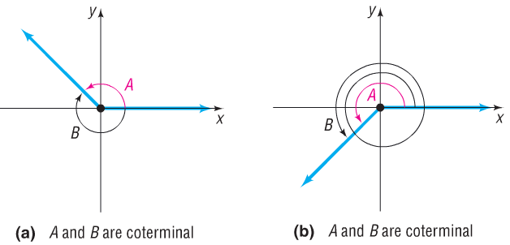
Two angles in standard position are said to be coterminal if they have the same terminal side.
Copyright © 2012 Pearson Education, Inc. Publishing as Prentice Hall.

Slide 13
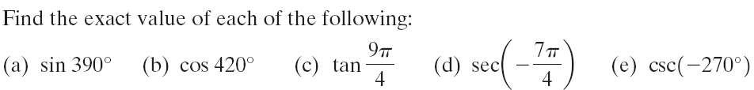



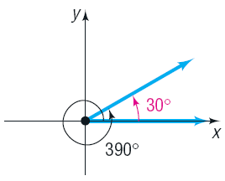
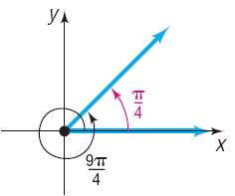
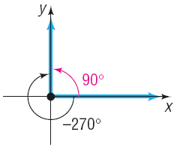


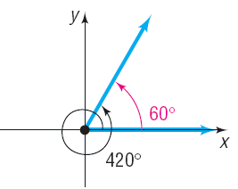
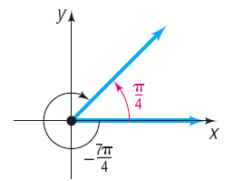

Slide 14
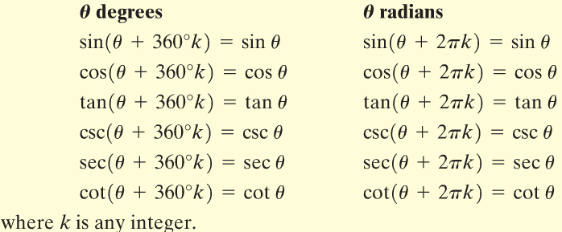
Copyright © 2012 Pearson Education, Inc. Publishing as Prentice Hall.

Slide 15
Copyright © 2012 Pearson Education, Inc. Publishing as Prentice Hall.

Slide 16
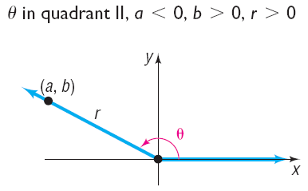
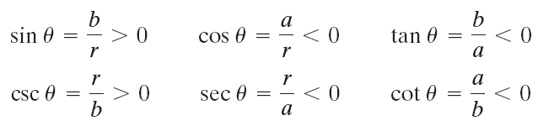
Copyright © 2012 Pearson Education, Inc. Publishing as Prentice Hall.

Slide 17
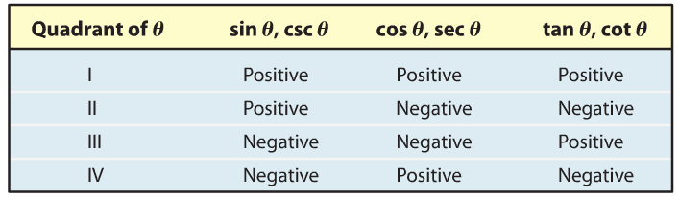
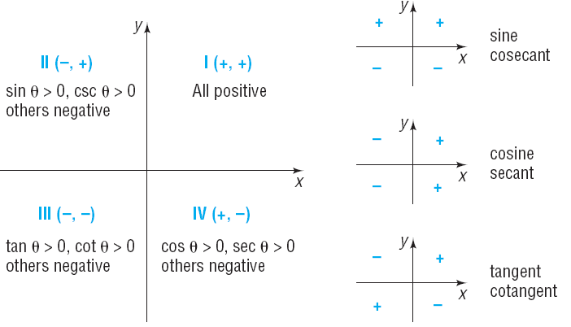
Copyright © 2012 Pearson Education, Inc. Publishing as Prentice Hall.

Slide 18
If and , name the quadrant in which the angle lies.
For an angle must be in quadrant I or II.
For an angle must be in quadrant II or III.
Therefore, this angle must lie in quadrant II.
Copyright © 2012 Pearson Education, Inc. Publishing as Prentice Hall.

Slide 19
Copyright © 2012 Pearson Education, Inc. Publishing as Prentice Hall.

Slide 20
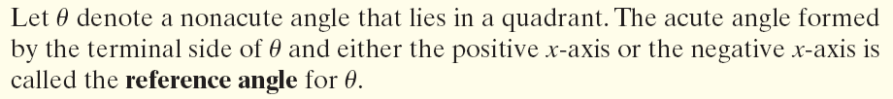
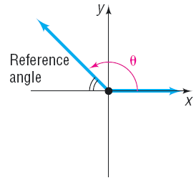
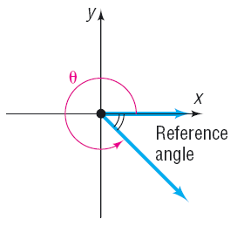
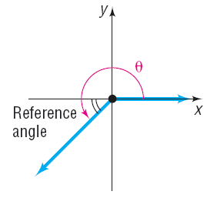
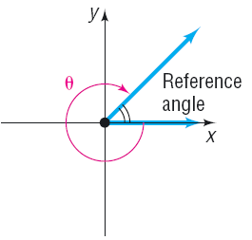
Copyright © 2012 Pearson Education, Inc. Publishing as Prentice Hall.

Slide 21
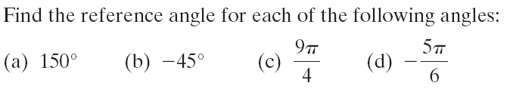
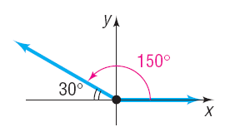
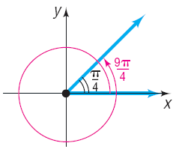
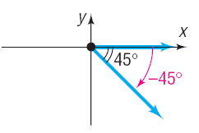
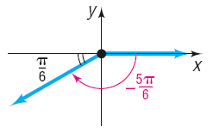
Copyright © 2012 Pearson Education, Inc. Publishing as Prentice Hall.

Slide 22

Copyright © 2012 Pearson Education, Inc. Publishing as Prentice Hall.

Slide 23

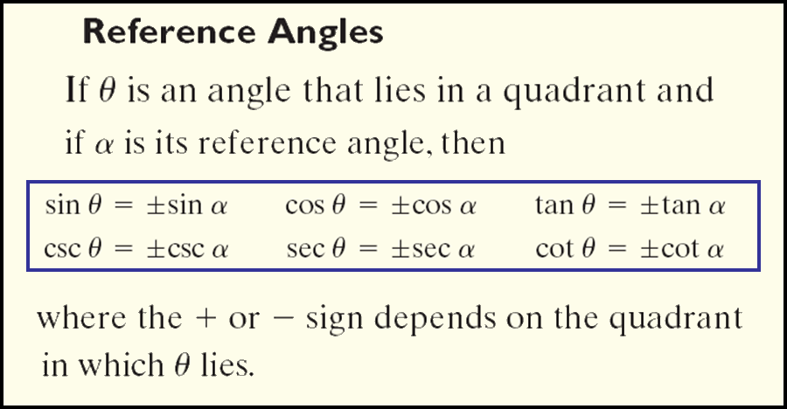
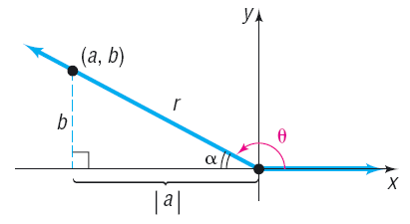
Copyright © 2012 Pearson Education, Inc. Publishing as Prentice Hall.

Slide 24
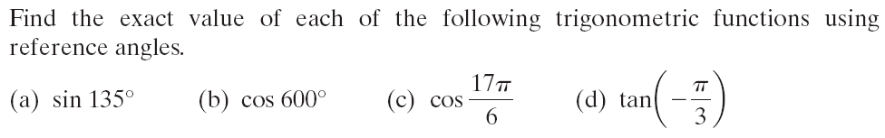
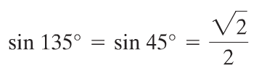

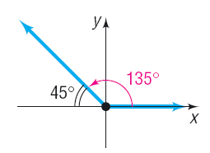
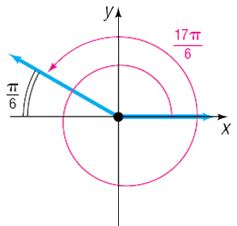
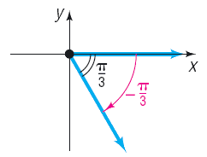
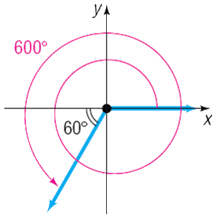


Copyright © 2012 Pearson Education, Inc. Publishing as Prentice Hall.

Slide 25
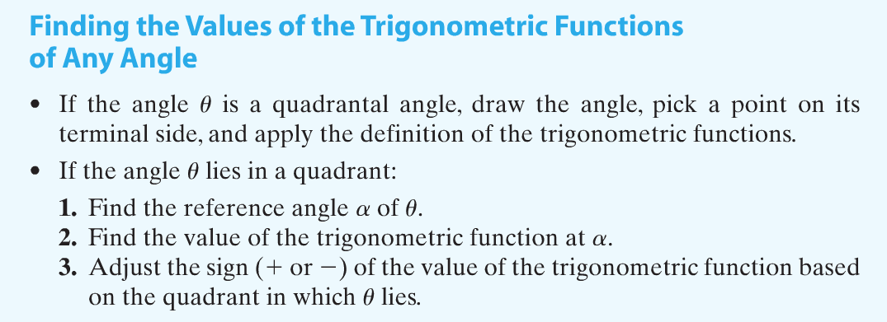
Copyright © 2012 Pearson Education, Inc. Publishing as Prentice Hall.

Slide 26
Copyright © 2012 Pearson Education, Inc. Publishing as Prentice Hall.

Slide 27
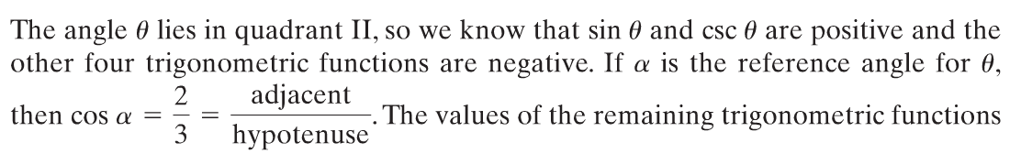
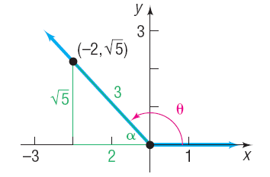


Copyright © 2012 Pearson Education, Inc. Publishing as Prentice Hall.

Slide 28



Copyright © 2012 Pearson Education, Inc. Publishing as Prentice Hall.

